Slide 1
RASD
Federico Betti – Tommaso Bianchi

Slide 2
Product Functions
Travel
Meeting

Slide 3
User Characteristics
Guest
User
Administrator
System Manager

Slide 4
Goals
G1 Allow someone to visit the homepage of the system and to register himself providing a valid email, a password and a unique nickname. As an alternative, an external login provider, such as Google+, can be used.
G2 Users can log into the system.
G3 Allow a user to visit its profile and to see a detailed schedule of any day containing all the meetings he is attending and all the travels the system has planned him.
G4 Allow a user to edit all information in its profile (e.g. displayed name, phone number, company, website, social accounts).
G5 Allow a user to create a meeting and to invite other users to attend it.
G6 Create a warning each time it is not possible to reach a meeting location from the previous one in time.
G7 Allow a user to specify flexible breaks during the day.
G8 Manage users’ travels between subsequent meetings, suggesting the best mobility option according to their preference list.

Slide 5
Goals
G1 Allow someone to visit the homepage of the system and to register himself providing a valid email, a password and a unique nickname. As an alternative, an external login provider, such as Google+, can be used.
G2 Users can log into the system.
G3 Allow a user to visit its profile and to see a detailed schedule of any day containing all the meetings he is attending and all the travels the system has planned him.
G4 Allow a user to edit all information in its profile (e.g. displayed name, phone number, company, website, social accounts).
G5 Allow a user to create a meeting and to invite other users to attend it.
G6 Create a warning each time it is not possible to reach a meeting location from the previous one in time.
G7 Allow a user to specify flexible breaks during the day.
G8 Manage users’ travels between subsequent meetings, suggesting the best mobility option according to their preference list.

Slide 6
Allow a user to create a meeting and to invite other users to attend it.
G5.1 Allow the administrator to categorize the meeting.
G5.2 Allow the administrator to change title, abstract and location of the meeting.
G5.3 Allow the administrator to nominate other administrators.
G5.4 Allow the administrator to send invitations and remove participants.
G5.5 Allow the team to communicate between them, to share files and to save personal notes about the meeting.
G5.6 Allow the invited users to accept or decline the meeting or to propose a rescheduling in a different time slot.
G5.7 Allow the administrator to change the date of the meeting after a rescheduling has been proposed.
G5.8 Allow the administrator to poll the team to reschedule the meeting; if everyone accepts the rescheduling, the date changes.
G5.9 Allow the administrator to create a copy of a meeting with the same team and settings on another date.
G5.10 Allow the administrator to see who’s late at the meeting.

Slide 7
Allow a user to create a meeting and to invite other users to attend it.
[R5] A user must be logged into the system to perform any action except registering and logging in.
[R11] Each meeting has at least two participants.
[R12] Each meeting has at least one administrator.
[R13] Each meeting has a title, a date and a location.
[R14] Each participant in a meeting can access shared files and the chat.
[R15] Users participate in a meeting if and only if they accept the invitation.
[R16] Users do not participate in a meeting if they decline the invitation.
[R17] Users can write in the chat of a meeting if and only if they have received and accepted an invitation to it.

Slide 8
Allow a user to specify flexible breaks during the day.
[R5] A user must be logged into the system to perform any action except registering and logging in.
[R18] The system suggests you a time, according to your settings, to have a break such that no meeting overlaps with it; if no time slot is valid, a warning is generated.
[D6] Users can have lunch everywhere.

Slide 9
Manage users’ travels between subsequent meetings.
G8.1 Allow a user to create a preference list and constraints about the way he wants to travel.
[R5] A user must be logged into the system to perform any action except registering and logging in.
[R19] At least one travel mean is available in the preference list.
[R20] The travel mean suggested by the system is always the first in the weighted preference list that satisfied all the constraints; if no travel mean satisfied all the constraints than the system suggests the fastest one.

Slide 10
Manage users’ travels between subsequent meetings.
[D5] Each user has at least one default location.
[D7] Each user has a preference list.
[D8] All users always have a position.
[D9] External shortest path provider is always able to retrieve a path between any two locations.
[D10] Each user is always able to communicate with our servers.
[D11] The system does not differentiate between a travel mean that is shared and one that is owned.
[D12] The system treats the taxis as a driving travel mean and not as public transportation.
[D13] If a user accepts the invitation to a meeting, then he really attends to it.

Slide 11
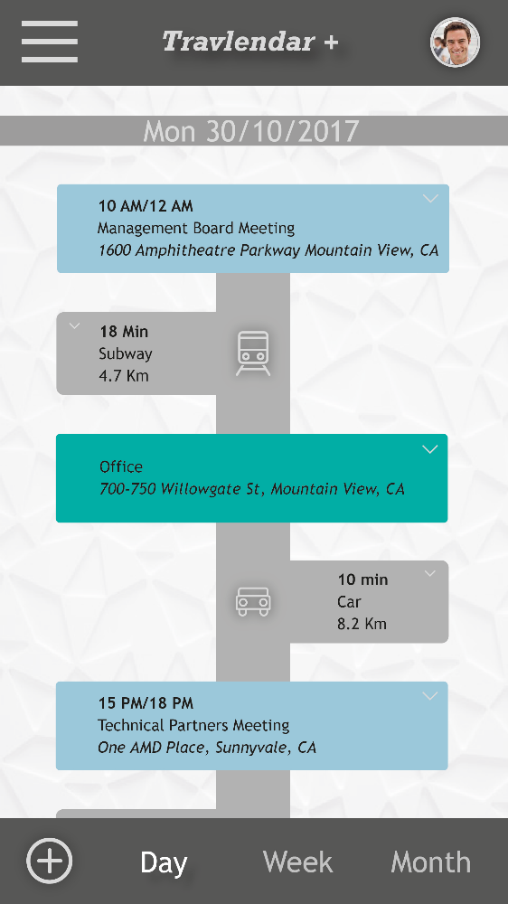
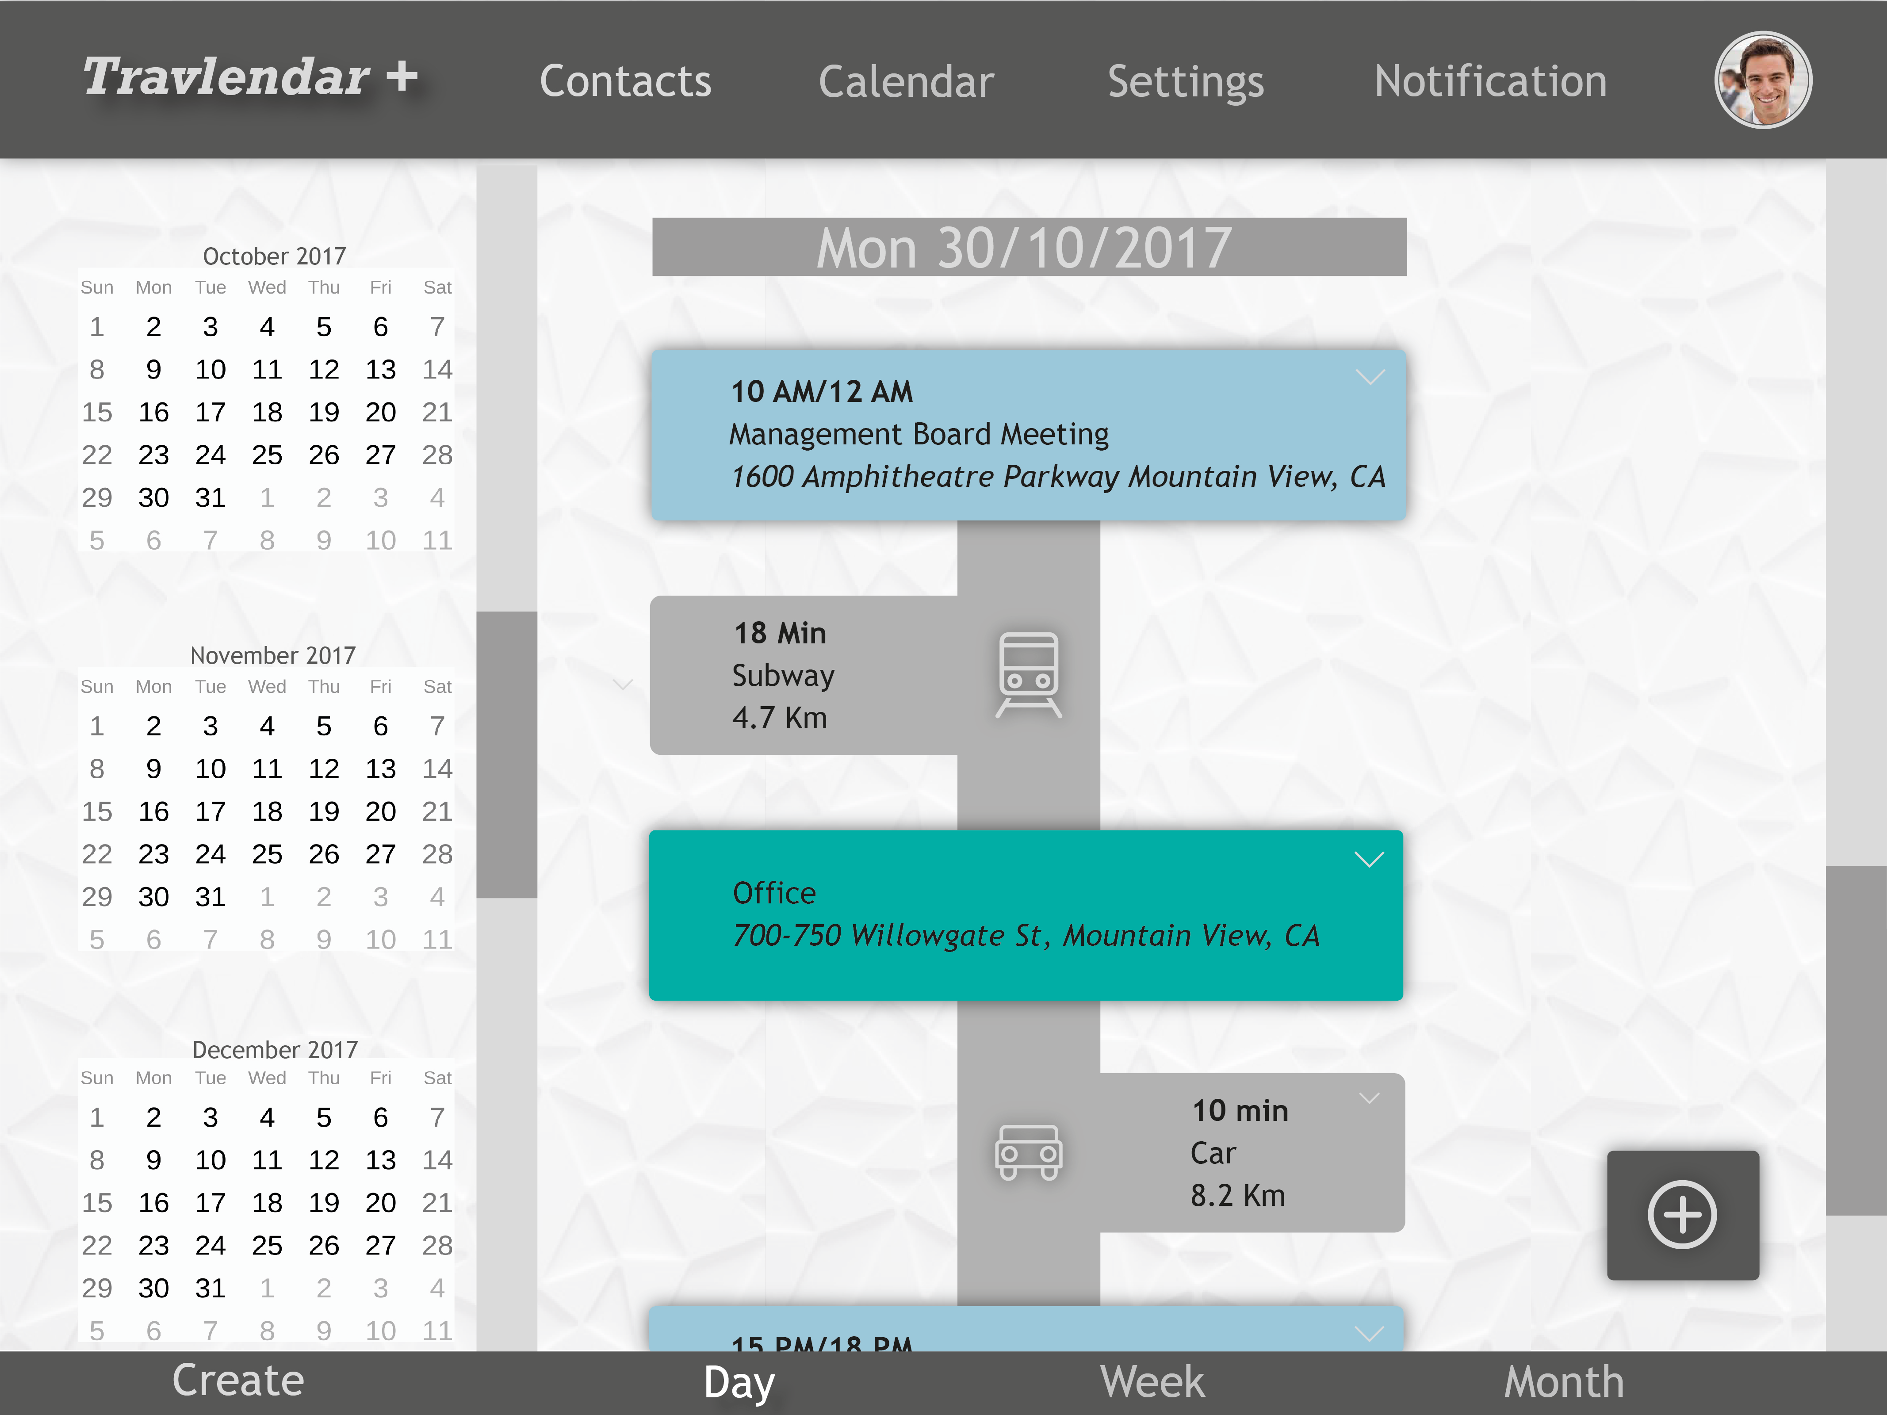
Mockup - Calendar

Slide 12
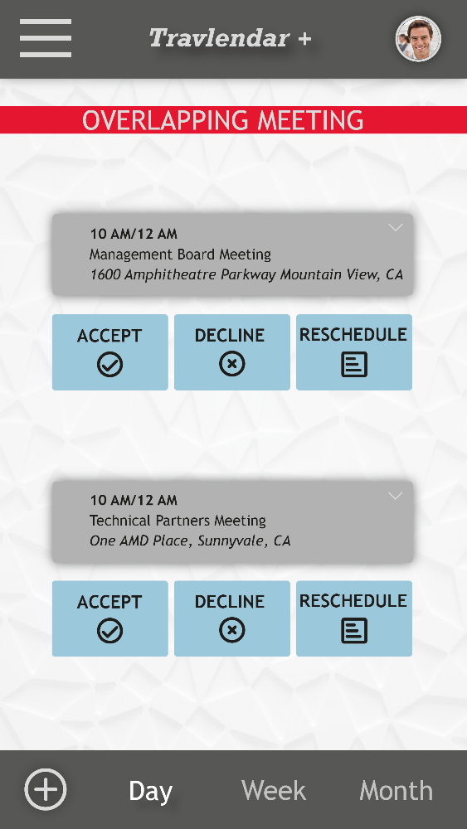
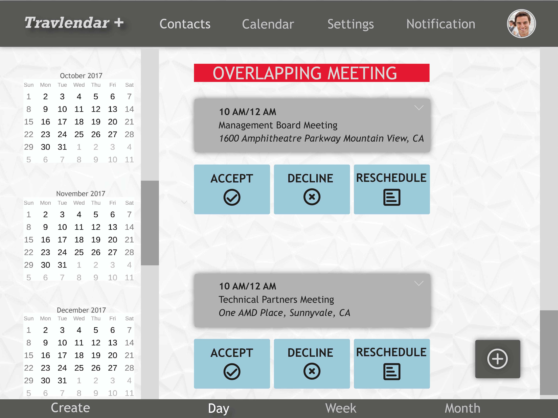
Mockup - Warning

Slide 14
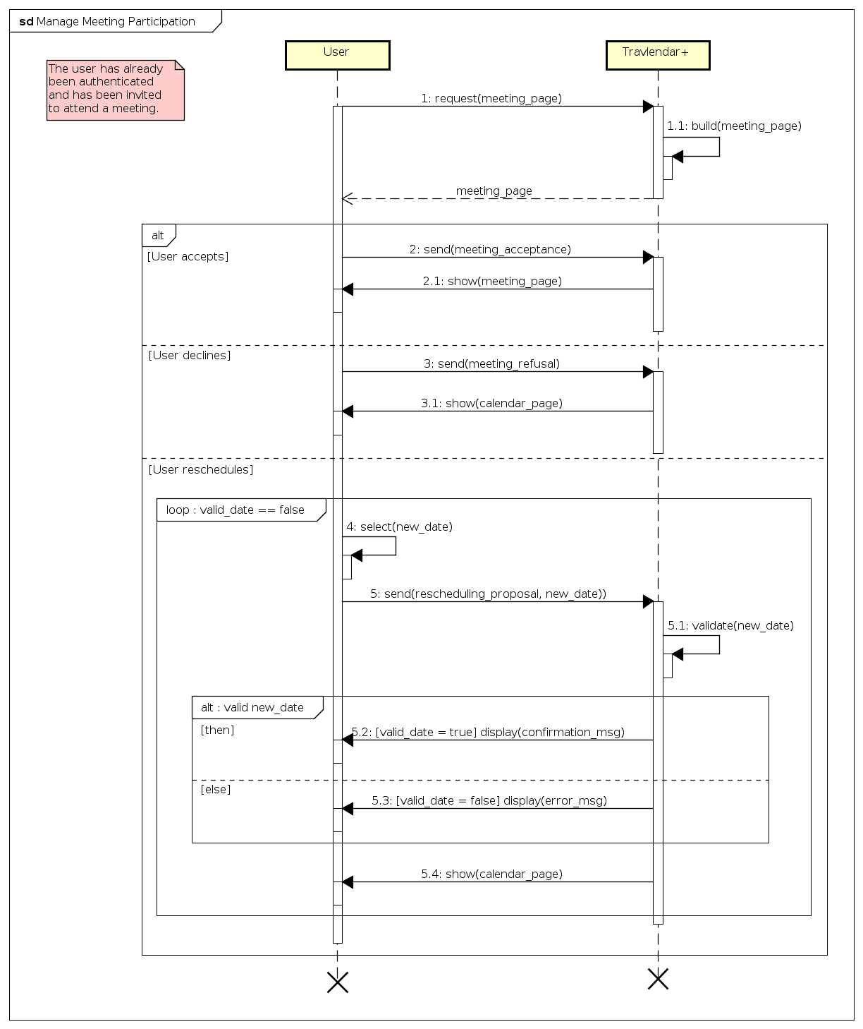
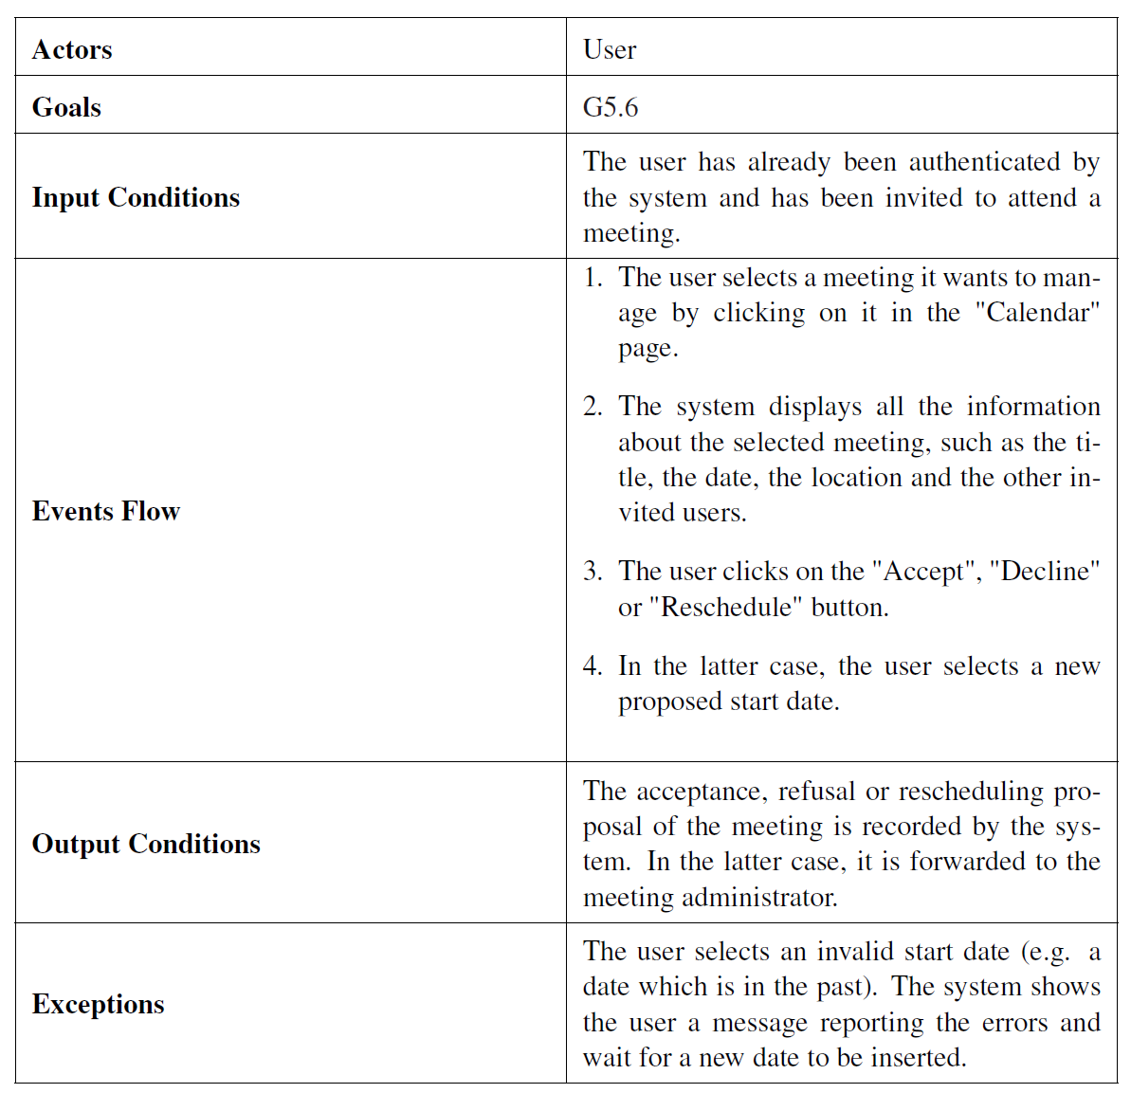
Manage Meeting Participation

Slide 15
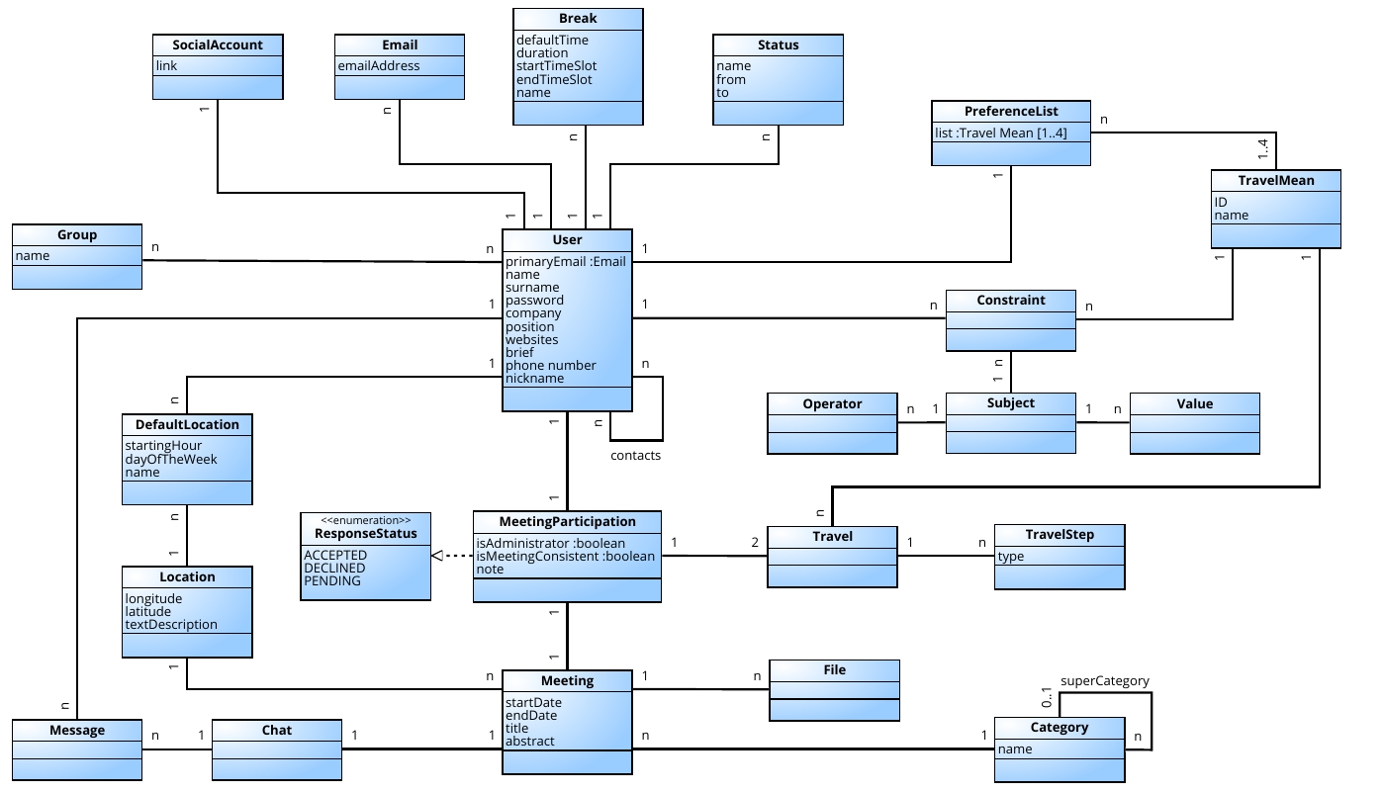
Class Diagram

Slide 16
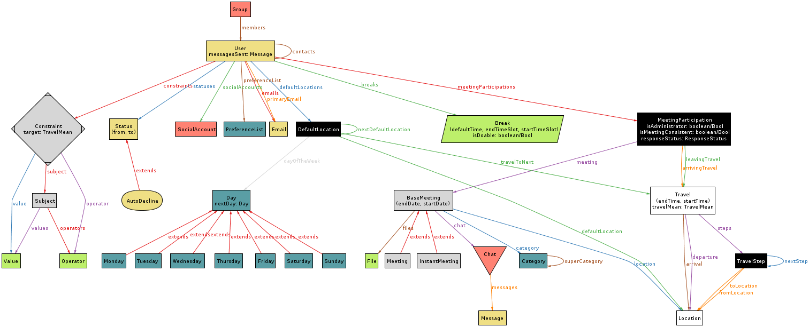
Alloy Metamodel

